Slide 1
What is Data Science?
Data science is a deep study of the massive amount of data, which involves extracting meaningful insights from raw, structured, and unstructured data that is processed using the scientific method, different technologies, and algorithms.
It is a multidisciplinary field that uses tools and techniques to manipulate the data so that you can find something new and meaningful.
Data science uses the most powerful hardware, programming systems, and most efficient algorithms to solve the data related problems. It is the future of artificial intelligence.
The main purpose of data science is to compute better decision making.
Data science is the science of analyzing raw data using statistics and machine learning techniques with the purpose of drawing conclusions about that information.

Slide 2
What is Data Science?
In short, we can say that data science is all about:
Asking the correct questions and analyzing the raw data.
Modeling the data using various complex and efficient algorithms.
Visualizing the data to get a better perspective.
Understanding the data to make better decisions and finding the final result.
Example:
Let suppose we want to travel from station A to station B by car. Now, we need to take some decisions such as which route will be the best route to reach faster at the location, in which route there will be no traffic jam, and which will be cost-effective. All these decision factors will act as input data, and we will get an appropriate answer from these decisions, so this analysis of data is called the data analysis, which is a part of data science.

Slide 3
Why Do We Need Data Science?
What is Data?
A set of values of qualitative or quantitative variables.
A set of values:
The first term to concentrate on is “a set of values” – to have data, we require a set of values to include. In statistics, this set of values is known as the population.
For example, that set of values needed to answer your question might be all websites or applications or it might be the set of all people getting a particular drug or set of people visiting a particular website. But generally, it’s a set of things that you’re going to make measurements on.

Slide 4
Why Do We Need Data Science?
Variables:
The next thing to focus on is “variables” – variables are measurements or characteristics of an item.
For example, you could be measuring the weight of a person, or you are estimating the amount of time a person visits a website or app. Or it may be a further qualitative characteristic you are trying to measure, like what a person clicks on a website, or whether you think the person visiting is male or female.
Qualitative and quantitative variables:
Finally, we have both “qualitative and quantitative variables“. Qualitative variables are information about qualities.
They are things like country of origin, gender, religion, etc. They’re usually represented by words, not numbers, and they are not indexed or ordered. On the other hand, quantitative variables are information regarding quantities.
Quantitative measurements are normally represented by numbers and are estimated on a constant ordered scale; they’re something like weight, height, age, and blood pressure.

Slide 5
What is Big Data?
Big Data literally means large amounts of data.
Big data is the pillar behind the idea that one can make useful inferences with a large body of data that wasn’t possible before with smaller datasets. So extremely large data sets may be analyzed computationally to reveal patterns, trends, and associations that are not transparent or easy to identify.

Slide 6
Why is everyone interested in Big Data?
Big data is everywhere!
Every time you go to the web and do something that data is collected, every time you buy something from one of the e-commerce your data is collected.
Whenever you go to store data is collected at the point of sale, when you do Bank transactions that data is there, when you go to Social networks like Facebook, Twitter that data is collected. Now, these are more social data, but the same thing is starting to happen with real engineering plants.
Real-time data is collected from plants all over the world. Not only these if you are doing much more sophisticated simulation, molecular simulations, which generates tons of data that is also collected and stored.

Slide 7
How much data is Big Data?
Google processes 20 Petabytes(PB) per day (2008)
Facebook has 2.5 PB of user data + 15 TB per day (2009)
eBay has 6.5 PB of user data + 50 TB per day (2009)
CERN’s Large Hadron Collider(LHC) generates 15 PB a year

Slide 8
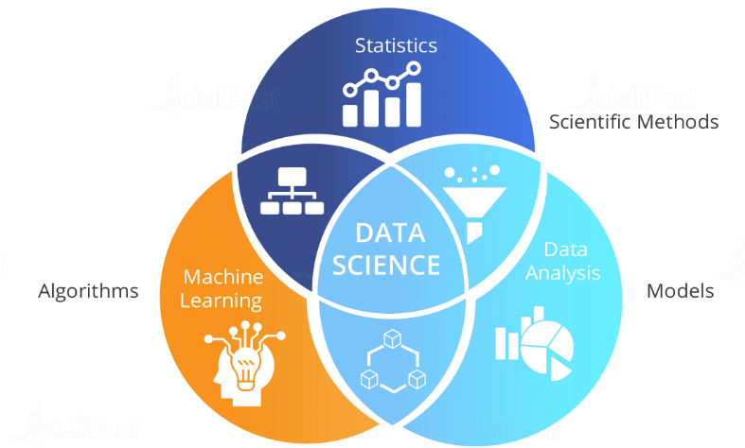
Why Data Science?
Data science is all about using information to help us make better choices and solve problems. It is like having a superpower for decision-making.

Slide 9
Why Data Science?
Smart Decisions: With data science, we can analyze data to make smart decisions in business, health, and many other areas.
Solving Problems : It helps us solve tricky problems. For example, it can help doctors find better ways to treat diseases.
Discovering Patterns : Data science helps us find patterns in data that we might not see on our own. It’s like finding hidden treasures.
Saving Time and Money: By using data, we can save time and money. For businesses, this means more profit.
Endless Possibilities : Data science is a powerful tool with endless possibilities. It’s like having a magic wand for understanding the world.
In a nutshell, data science is all about using data to make life better, easier, and more exciting.

Slide 10
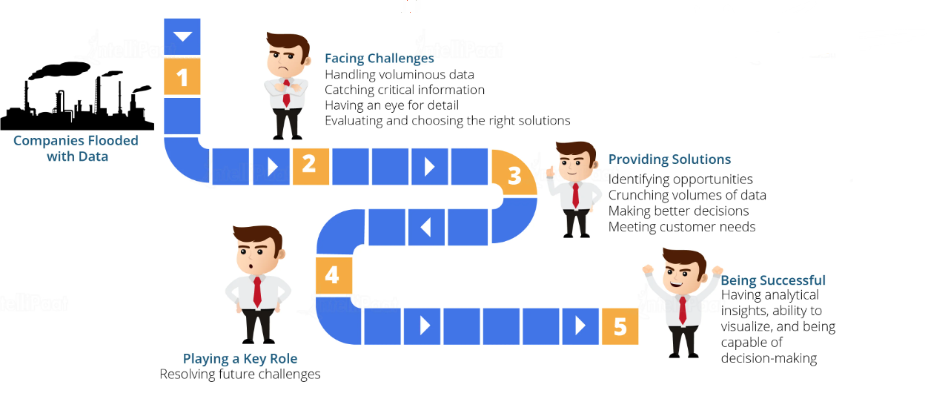

Slide 11
Prerequisite for Data Science
Non-Technical Prerequisite:
Curiosity: To learn data science, one must have curiosities. When you have curiosity and ask various questions, then you can understand the business problem easily.
Critical Thinking: It is also required for a data scientist so that you can find multiple new ways to solve the problem with efficiency.
Communication skills: Communication skills are most important for a data scientist because after solving a business problem, you need to communicate it with the team.

Slide 12
Prerequisite for Data Science
Technical Prerequisite:
Machine learning: To understand data science, one needs to understand the concept of machine learning. Data science uses machine learning algorithms to solve various problems.
Mathematical modeling: Mathematical modeling is required to make fast mathematical calculations and predictions from the available data.
Statistics: Basic understanding of statistics is required, such as mean, median, or standard deviation. It is needed to extract knowledge and obtain better results from the data.
Computer programming: For data science, knowledge of at least one programming language is required. R, Python, Spark are some required computer programming languages for data science.
Databases: The depth understanding of Databases such as SQL, is essential for data science to get the data and to work with data.

Slide 13
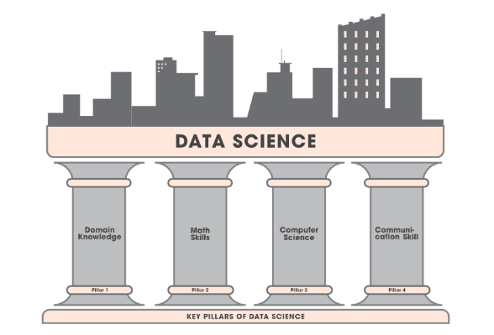
Key Pillars of Data Science
Usually, data scientists come from various educational and work experience backgrounds, most should be proficient in, or in an ideal case be masters in four key areas.

Slide 14
Key Pillars of Data Science
Domain Knowledge:
Most people thinking that domain knowledge is not important in data science but it is essential. The foremost objective of data science is to extract useful insights from that data so that it can be profitable to the company’s business.
You need to know how to ask the right questions from the right people so that you can perceive the appropriate information you need to obtain the information you need.
There are some visualization tools used on the business end like Tableau that help you display your valuable results or insights in a proper non-technical format such as graphs or pie charts that business people can understand.

Slide 15
Key Pillars of Data Science
Math Skills:
Linear Algebra, Multivariable Calculus & Optimization Techniques: These three things are very important as they help us in understanding various machine learning algorithms that play an important role in Data Science.
Statistics & Probability: Understanding of Statistics is very significant as this is a part of Data analysis. Probability is also significant to statistics and it is considered a prerequisite for mastering machine learning.

Slide 16
Key Pillars of Data Science
Computer Science:
Programming Knowledge: One needs to have a good grasp of programming concepts such as Data structures and Algorithms. The programming languages used are Python, R, Java, Scala. C++ is also useful in some places where performance is very important.
Relational Databases: One needs to know databases such as SQL or Oracle so that he/she can retrieve the necessary data from them whenever required.
Non-Relational Databases: There are many types of non-relational databases but mostly used types are Cassandra, HBase, MongoDB, CouchDB, Redis, Dynamo.
Machine Learning: It is one of the most vital parts of data science and the hottest subject of research among researchers so each year new advancements are made in this. One at least needs to understand basic algorithms of Supervised and Unsupervised Learning. There are multiple libraries available in Python and R for implementing these algorithms.
Distributed Computing: It is also one of the most important skills to handle a large amount of data because one can’t process this much data on a single system. The tools that mostly used are Apache Hadoop and Spark. The two major parts of these tolls are HDFS(Hadoop Distributed File System) that is used for collecting data over a distributed file system. Another part is map-reduce, by which we manipulate the data. One can write map-reduce in programs in Java or Python. There are various other tools such as PIG, HIVE, etc.

Slide 17
Key Pillars of Data Science
Communication Skill:
It includes both written and verbal communication. What happens in a data science project is after drawing conclusions from the analysis, the project has to be communicated to others. Sometimes this may be a report you send to your boss or team at work. Other times it may be a blog post. Often it may be a presentation to a group of colleagues. Regardless, a data science project always involves some form of communication of the projects’ findings. So it’s necessary to have communication skills for becoming a data scientist.

Slide 18
Roles & Responsibilities of a Data Scientist
A data scientist is someone who integrates the skills of software programmer, statistician and storyteller/artist to extract the nuggets of gold hidden under mountains of data.
Management: The Data Scientist plays an insignificant managerial role where he supports the construction of the base of futuristic and technical abilities within the Data and Analytics field in order to assist various planned and continuing data analytics projects.
Analytics: The Data Scientist represents a scientific role where he plans, implements, and assesses high-level statistical models and strategies for application in the business’s most complex issues. The Data Scientist develops econometric and statistical models for various problems including projections, classification, clustering, pattern analysis, sampling, simulations, and so forth.
Strategy/Design: The Data Scientist performs a vital role in the advancement of innovative strategies to understand the business’s consumer trends and management as well as ways to solve difficult business problems, for instance, the optimization of product fulfillment and entire profit.

Slide 19
Roles & Responsibilities of a Data Scientist
Collaboration: The role of the Data Scientist is not a solitary role and in this position, he collaborates with superior data scientists to communicate obstacles and findings to relevant stakeholders in an effort to enhance drive business performance and decision-making.
Knowledge: The Data Scientist also takes leadership to explore different technologies and tools with the vision of creating innovative data-driven insights for the business at the most agile pace feasible. In this situation, the Data Scientist also uses initiative in assessing and utilizing new and enhanced data science methods for the business, which he delivers to senior management of approval.
Other Duties: A Data Scientist also performs related tasks and tasks as assigned by the Senior Data Scientist, Head of Data Science, Chief Data Officer, or the Employer.

Slide 20
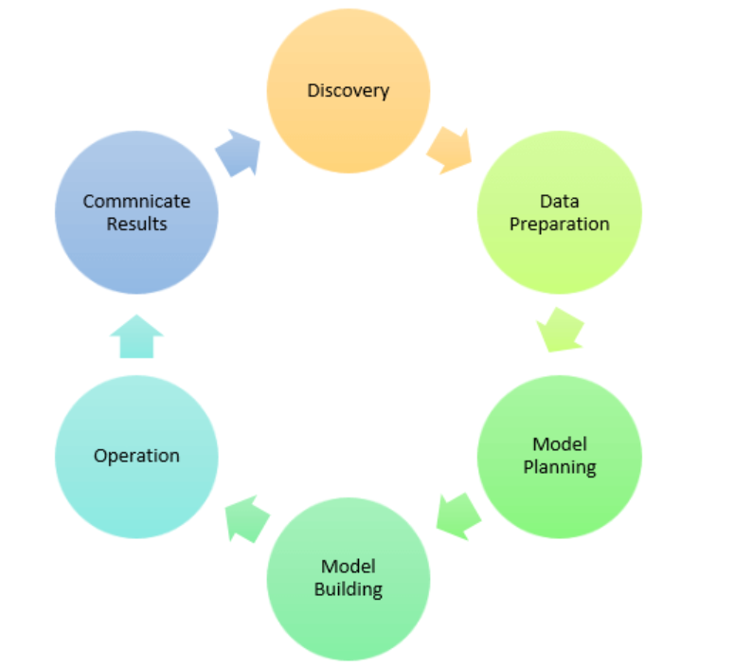
Data Science Process

Slide 21
Data Science Process
A data science process helps data scientists use the tools to find unseen patterns, extract data, and convert information to actionable insights that can be meaningful to the company.
This aids companies and businesses in making decisions that can help in customer retention and profits. Further, a data science process helps in discovering hidden patterns of structured and unstructured raw data.
The process helps in turning a problem into a solution by treating the business problem as a project.
The six steps of the data science process are as follows:
Frame the problem
Collect the raw data needed for your problem
Process the data for analysis
Explore the data
Perform in-depth analysis
Communicate results of the analysis

Slide 22
Step 1: Framing the Problem
Before solving a problem, the pragmatic thing to do is to know what exactly the problem is.
Data questions must be first translated to actionable business questions. People will more than often give ambiguous inputs on their issues. And, in this first step, you will have to learn to turn those inputs into actionable outputs.
A great way to go through this step is to ask questions like:
Who the customers are?
How to identify them?
What is the sale process right now?
Why are they interested in your products?
What products they are interested in?

Slide 23
Step 2: Collecting the Raw Data for the Problem
After defining the problem, you will need to collect the requisite data to derive insights and turn the business problem into a probable solution.
The process involves thinking through your data and finding ways to collect and get the data you need. It can include scanning your internal databases or purchasing databases from external sources.
Many companies store the sales data they have in customer relationship management (CRM) systems. The CRM data can be easily analyzed by exporting it to more advanced tools using data pipelines.

Slide 24
Step 3: Processing the Data to Analyze
After the first and second steps, when you have all the data you need, you will have to process it before going further and analyzing it. Data can be messy if it has not been appropriately maintained, leading to errors that easily corrupt the analysis.
The most common errors that you can encounter and should look out for are:
Missing values
Corrupted values like invalid entries
Time zone differences
Date range errors like a recorded sale before the sales even started.

Slide 25
Step 4: Exploring the Data
In this step, you will have to develop ideas that can help identify hidden patterns and insights.
You will have to find more interesting patterns in the data, such as why sales of a particular product or service have gone up or down.
You must analyze or notice this kind of data more thoroughly. This is one of the most crucial steps in a data science process.

Slide 26
Step 5: Performing In-depth Analysis
This step will test your mathematical, statistical, and technological knowledge.
You must use all the data science tools to crunch the data successfully and discover every insight you can.
You might have to prepare a predictive model that can compare your average customer with those who are underperforming.
You might find several reasons in your analysis, like age or social media activity, as crucial factors in predicting the consumers of a service or product.
You might find several aspects that affect the customer, like some people may prefer being reached over the phone rather than social media.
These findings can prove helpful as most of the marketing done nowadays is on social media.
How the product is marketed hugely affects sales, and you will have to target demographics that are not a lost cause after all. Once you are all done with this step, you can combine the quantitative and qualitative data that you have and move them into action.

Slide 27
Step 6: Communicating Results of this Analysis
After all these steps, it is vital to convey your insights and findings to the sales head and make them understand their importance. It will help if you communicate appropriately to solve the problem you have been given.
Proper communication will lead to action. In contrast, improper contact may lead to inaction.
You need to link the data you have collected and your insights with the sales head’s knowledge so that they can understand it better.
You can start by explaining why a product was underperforming and why specific demographics were not interested in the sales pitch. After presenting the problem, you can move on to the solution to that problem.
You will have to make a strong narrative with clarity and strong objectives.

Slide 28
Significance of Data Science Process
Yields better result and increases productivity
Report making is simplified
Speedy, accurate, and more reliable
Easy Storage and Distribution
Cost reduction
Safe and secure

Slide 29
Difference between Data Scientist, Data Analyst, and Data Engineer
Data Scientist | Data Analyst | Data Engineer
The focus will be on the futuristic display of data. | The main focus of a data analyst is on optimization of scenarios, for example how an employee can enhance the company’s product growth. | Data Engineers focus on optimization techniques and the construction of data in a conventional manner. The purpose of a data engineer is continuously advancing data consumption.
Data scientists present both supervised and unsupervised learning of data, say regression and classification of data, Neural networks, etc. | Data formation and cleaning of raw data, interpreting and visualization of data to perform the analysis and to perform the technical summary of data. | Frequently data engineers operate at the back end. Optimized machine learning algorithms were used for keeping data and making data to be prepared most accurately.
Skills required for Data Scientist are Python, R, SQL, Pig, SAS, Apache Hadoop, Java, Perl, Spark. | Skills required for Data Analyst are Python, R, SQL, SAS. | Skills required for Data Engineer are MapReduce, Hive, Pig Hadoop, techniques.

Slide 30
Why Should You Become a Data Scientist?
High Demand: Data scientists are really wanted in many industries because companies are relying more and more on data to make choices. This means there are plenty of job options, and they often come with good pay.
Exciting Career Prospects: If you decide to be a data scientist, you’ll get to work with new and cool technologies, deal with tough problems, and bring out new ideas. You’ll always have chances to learn and grow in this field.
Meaningful Contributions: Data scientists can find important information in data that helps companies make smart decisions, improve how they work, and stay competitive. You’ll feel good about the impact you’re making on businesses and society.
Diverse Skill Set: Data science gives you a set of skills that you can use in many jobs. You’ll be good at things like looking at data, programming, and understanding different subjects. This means you can choose from a lot of different careers.

Slide 31
Why Should You Become a Data Scientist?
Learning All the Time: The world of data science is always changing. This means there’s always something new to learn and discover. You’ll have to use your brain a lot, and you’ll get to learn more throughout your career.
Working with Different People: Data scientists often work with people from different fields, like business, engineering, marketing, and healthcare. This mix of ideas makes work interesting and lets you see things from new angles.
A Career That’s Ready for the Future: As more and more companies use digital tools and data, data scientists will keep being in demand. This means that if you become a data scientist, you’ll have a job that’s safe and can change with the times.

